Slide 1
EDA ANALYSIS: (binary and closed response) Part 2

Slide 2
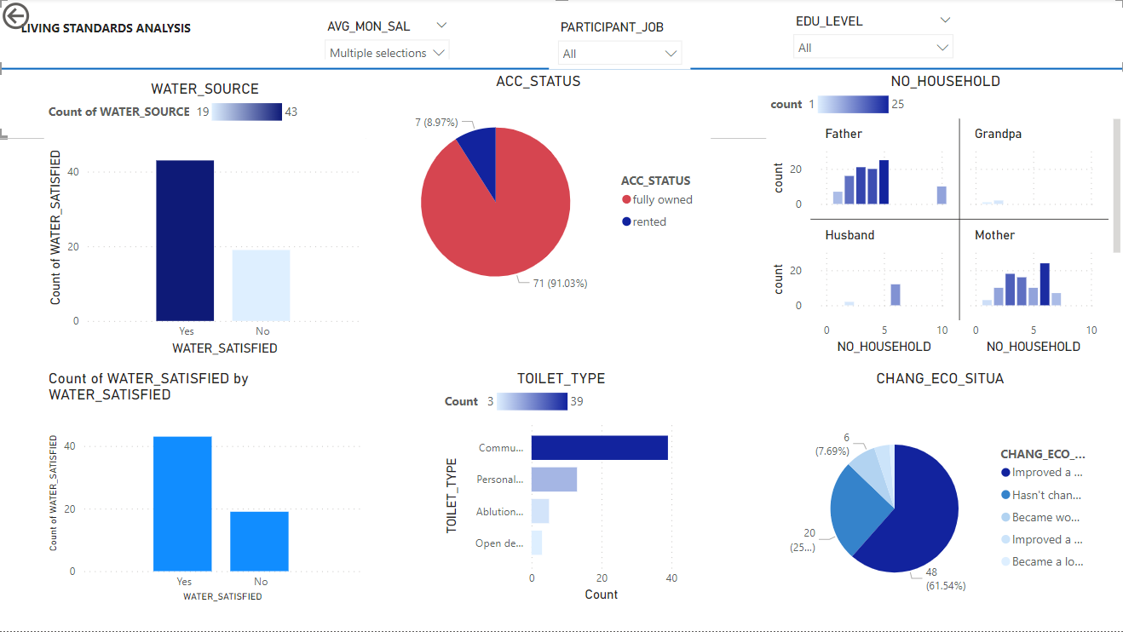
LIVING STANDARD DASHBOARD: Focus: Salary 500 and below
78 people of the 158 fully answered questionnaire had an average salary of 500 and below (49%)
The dominant household head was the father or mother and their accommodation was mostly fully owned.
They were most satisfied with their water source and their toilet type was mostly communal latrine
Just a few were renting which will be a salary drainer, with such a low pay

Slide 3
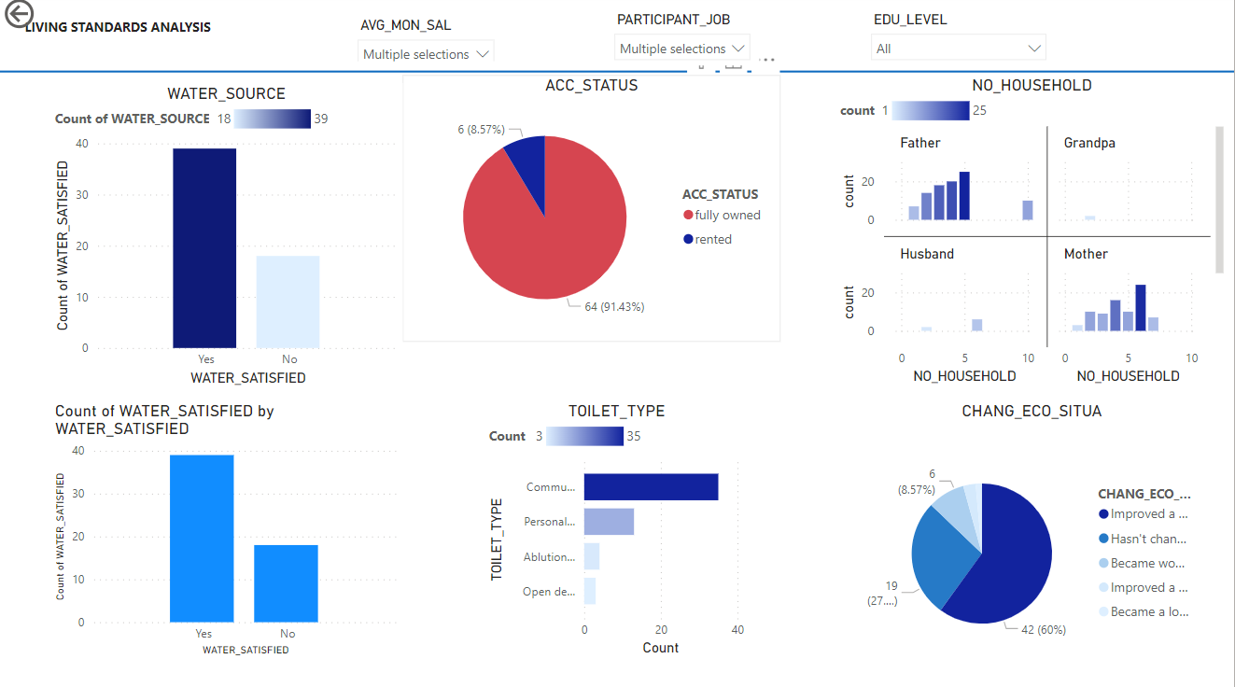
LIVING STANDARD DASHBOARD: Focus: Salary 500 and below (with participant not working)
90% of households with this average salary had participants as either unemployed or unpaid housework.8.6% of this group had become worst off.

Slide 4
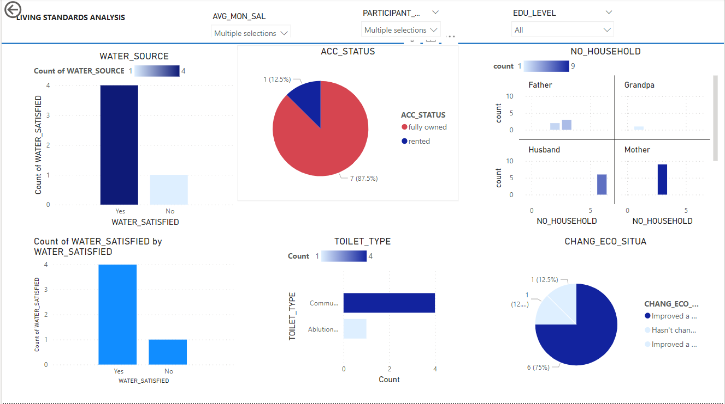
LIVING STANDARD DASHBOARD: Focus: Salary 500 and below (with participant working)
Mothers were mostly household
Head of these people
10% of households with this average salary had participants working and 75% of these people had improved their economic situation

Slide 5
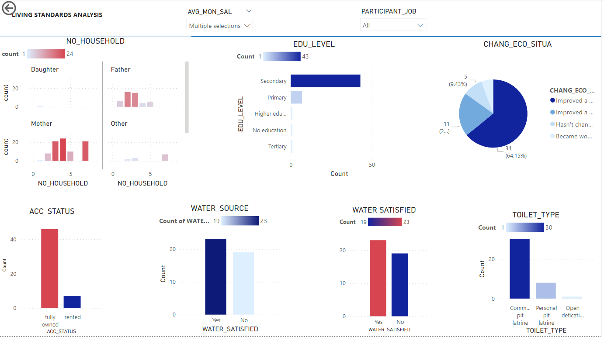
LIVING STANDARD DASHBOARD: Focus: Salary 1000s (all)
42 out of 158 had salaries in the 1000s
Overall for salary in the 1000s only 9.43%
Just a few complained their living condition had become worst off
The dominant household head were mothers with 3 as the number of households
The majority had houses as wholly owned and were satisfied with water sources as community tap

Slide 6
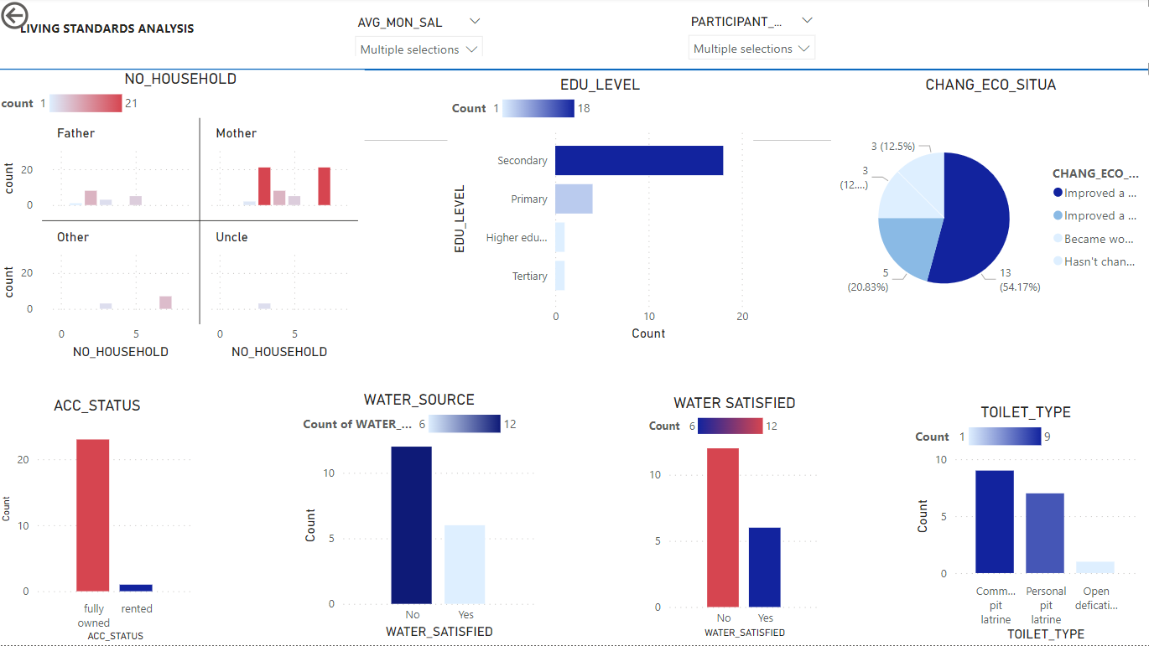
LIVING STANDARD DASHBOARD: Focus: Salary 1000s (with participant not working)
Out of salaries with 1000s as average
18 (43%) had household participants not working.
Since most of them had accommodation status as fully owned, these salaries didn’t mostly go into rent which explains only 12% becoming worst off despite participant not working

Slide 7
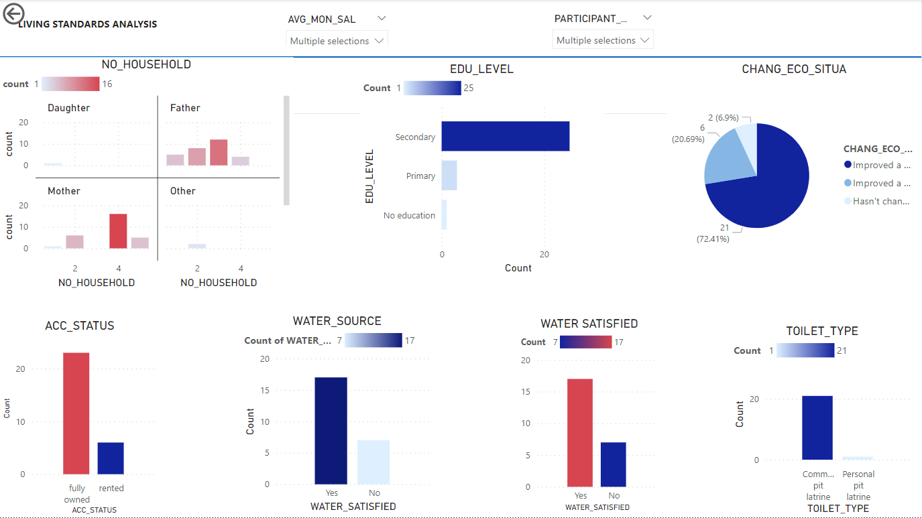
LIVING STANDARD DASHBOARD: Focus: Salary 1000s (with participant working)
58% of people with an average household salary in the 1000s had participants working.
Just a few rented and with participants working, which explains why 72.4% had living situation improve alot

Slide 8
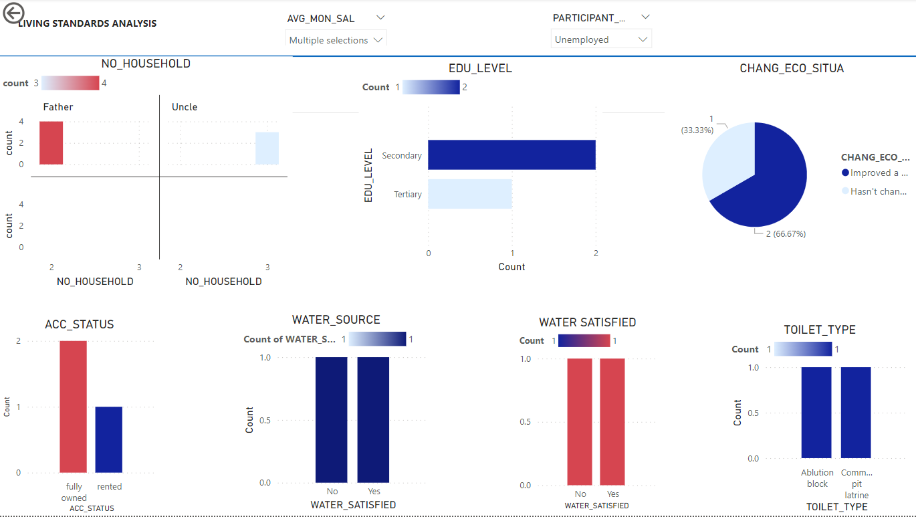
LIVING STANDARD DASHBOARD: Focus: Salary 2000s (with participant not working)
Out of the 12, only 3 had participants not working.
Since the average salary of this household was slightly high and most not renting, this didn’t affect their economic situation. 66.6% improved situation

Slide 9
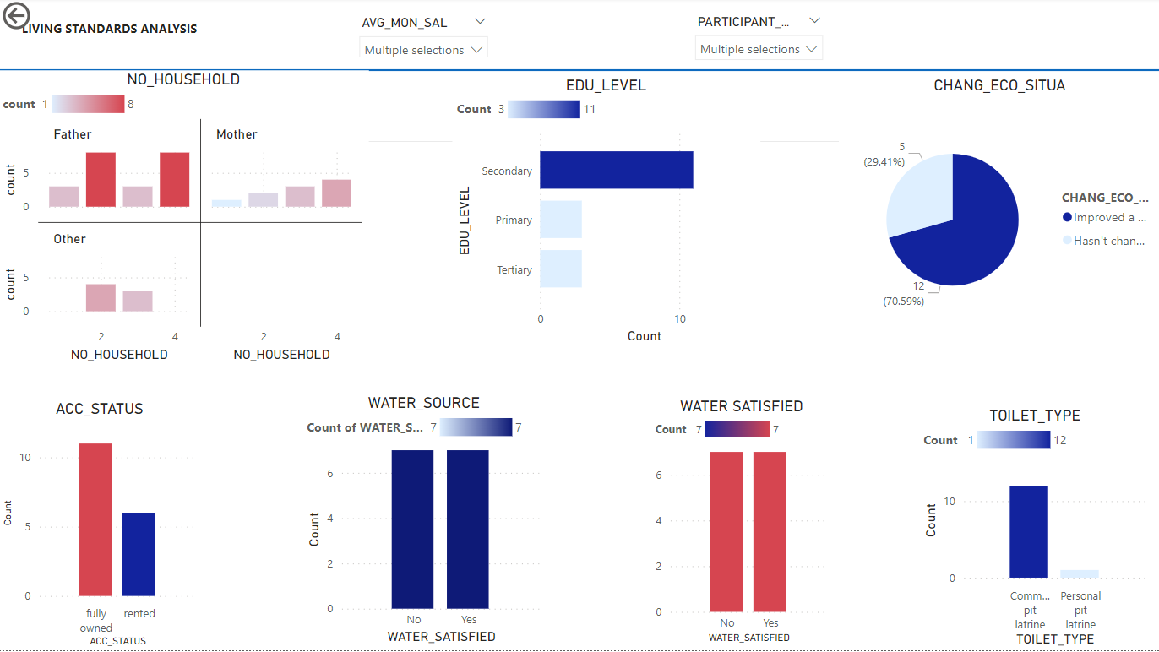
LIVING STANDARD DASHBOARD: Focus: Salary 2000s (all)
14 of 178 had an average salary in the 2000s
Fathers were seen as dominant household heads with household numbers 2 and 4 occurring the most
None of these people had their economic situation becoming worst off
They were indifferent of there water source

Slide 10

LIVING STANDARD DASHBOARD: Focus: Salary 2000s (with participant working)
8 of the 12 with the average salary in the 2000s had participants also working.
This could be a factor why the improvement situation, in this case, went up to 70.59% compared to households with participants not working

Slide 11
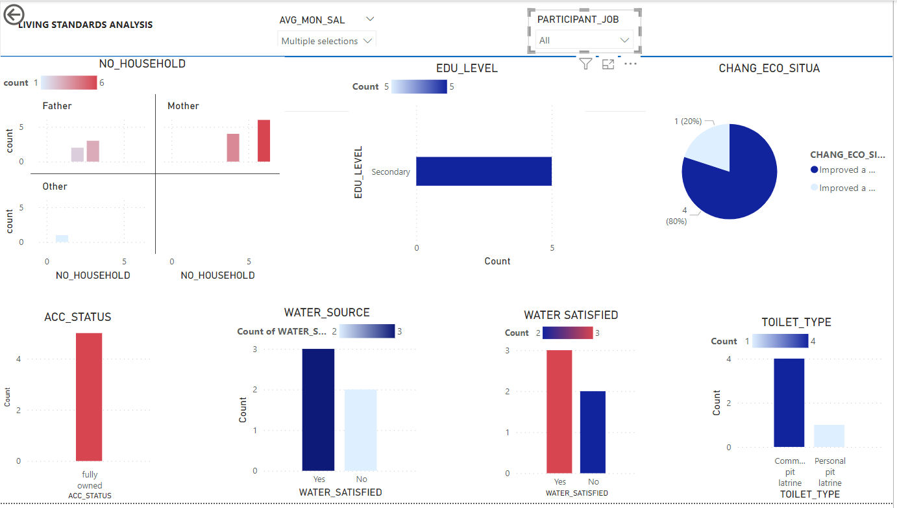
LIVING STANDARD DASHBOARD: Focus: Salary 3000s (all)
5 of the 178 population had an average salary in the 3000s
Mothers were mostly the household head of these houses and the dominant household number was 5.
80% had their economic situation improve a bit and 20% improved a lot
They all had accommodation situations as fully owned.

Slide 12
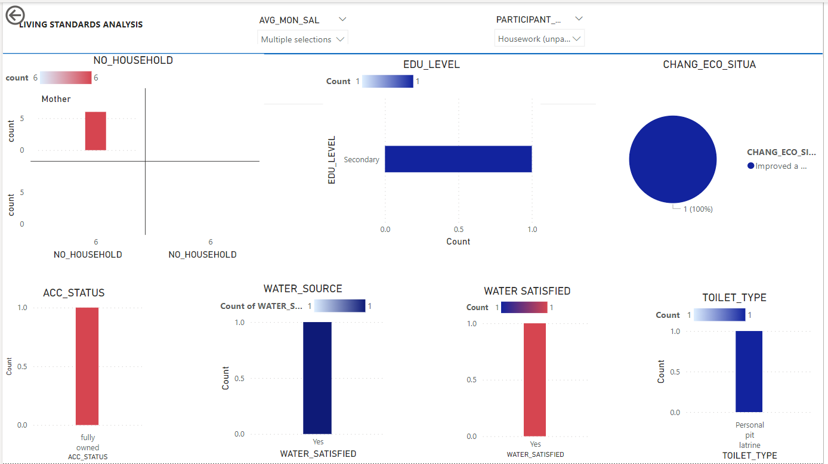
LIVING STANDARD DASHBOARD: Focus: Salary 3000s (with participant not working)
20% of these household had participant not working

Slide 13
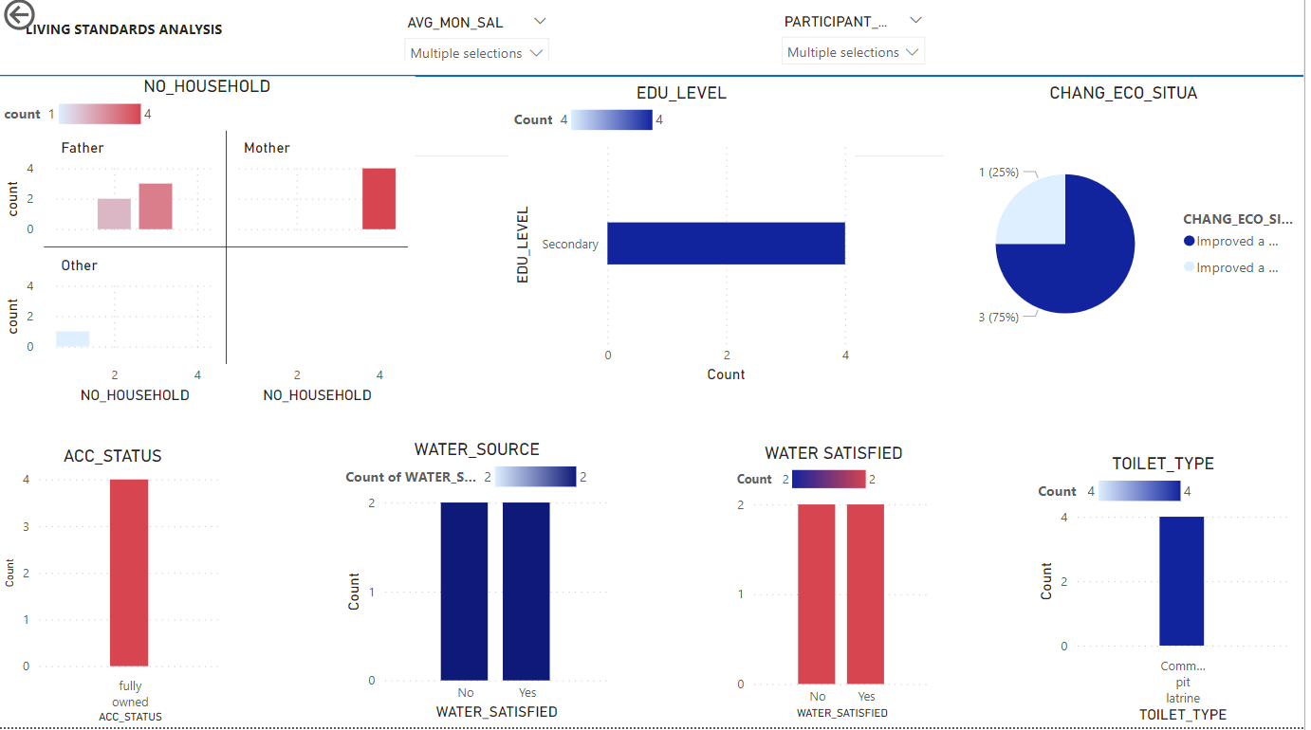
LIVING STANDARD DASHBOARD: Focus: Salary 3000s (with participant working)
80% of these people had participant working

Slide 14
Disaster analysis
Using the 2 disasters as indicators, looking at
Households that had experienced both flood and fire
Flood only
Fire only
None of the 2

Slide 15
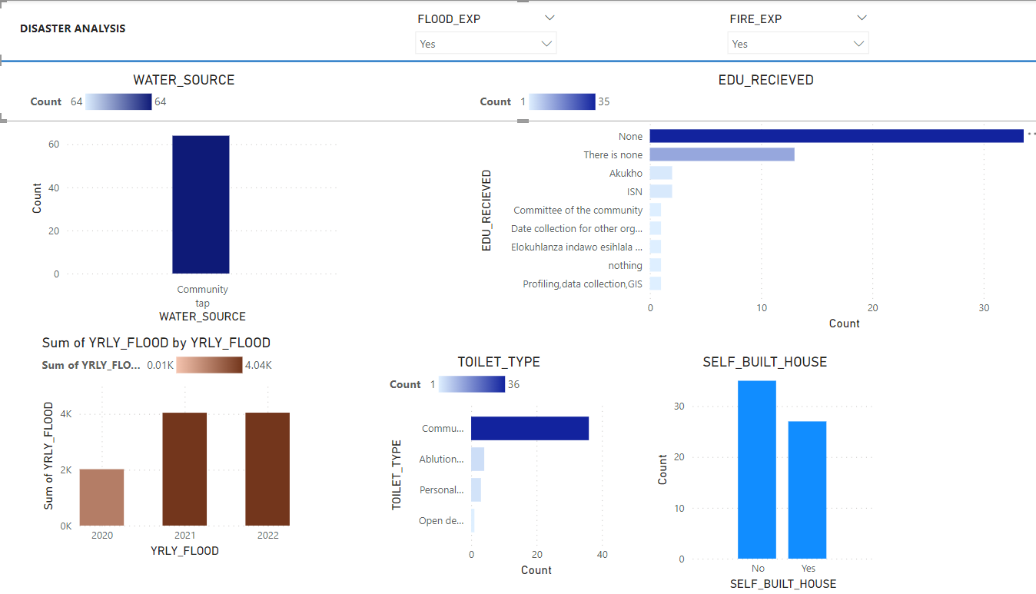
DISASTER ANALYSIS DASHBOARD: BOTH FIRE AND FLOOD
All households that had experienced both disasters were 40% of the population.
They all used community water, which is risky if there is a fire and you need to travel for water
The number of people who had self-built was fairly high as well
The toilet type was mostly community made once
77% of people who had experienced both had not received any social education

Slide 16
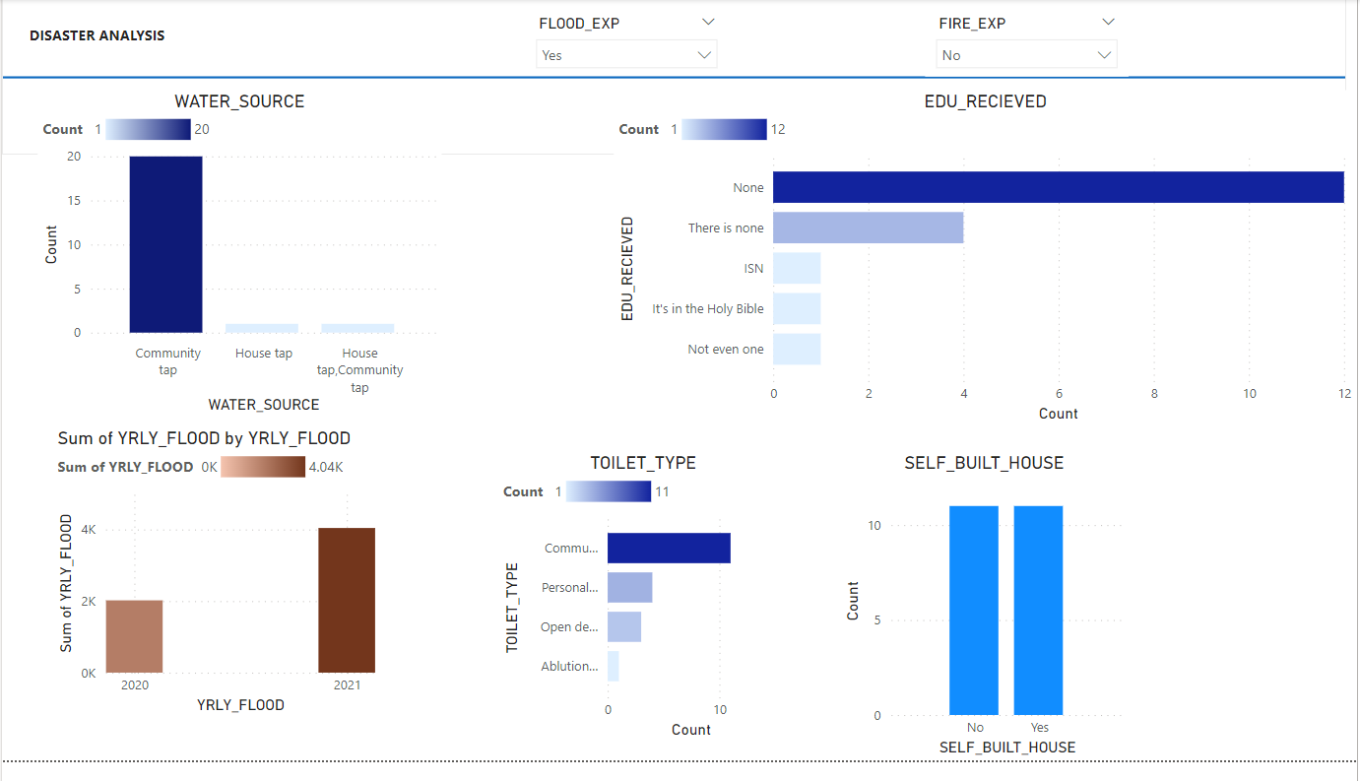
DISASTER ANALYSIS DASHBOARD: FLOOD ONLY
All households that had experienced flood only were 13.9% of the population.
Is the community not involved in vegetation a factor?
The number of people who had self-built was 50%.this can increase the effect of flood if self-built houses are not well structured
65% of people who had experienced both had not received any social education

Slide 17
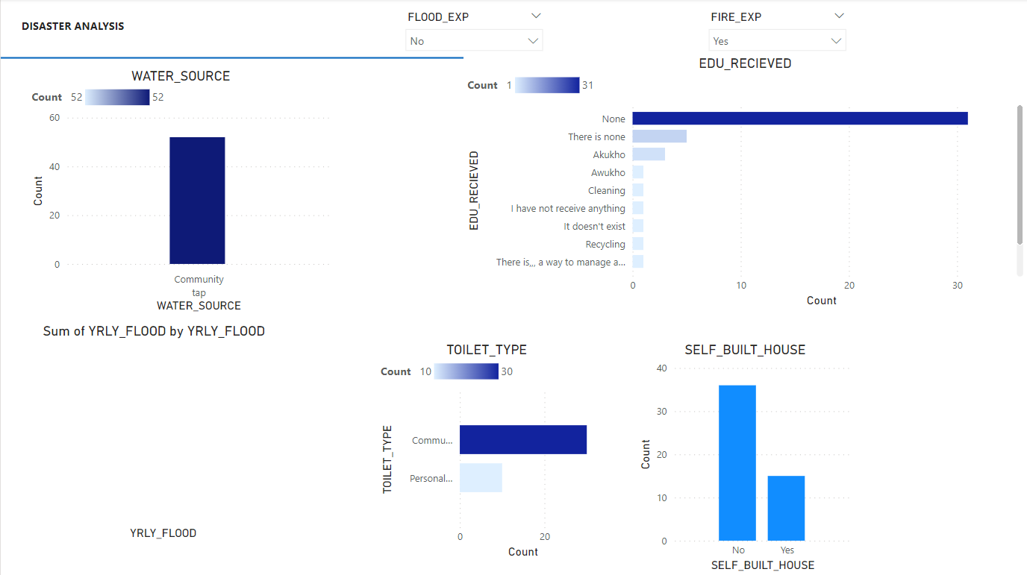
DISASTER ANALYSIS DASHBOARD: FIRE ONLY
All households that had experienced fire only were 32.9% of the population.
The number of people who had self-built was low
This means that this could be lack of information as 71% had not received any social training

Slide 18
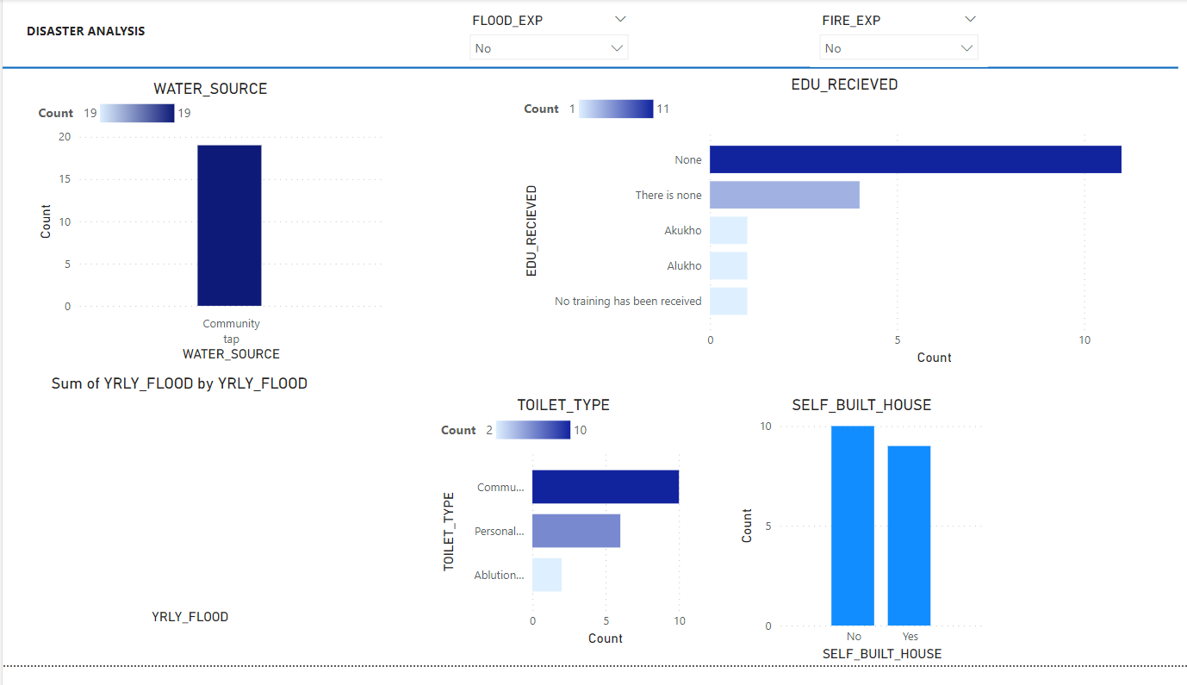
DISASTER ANALYSIS DASHBOARD: NONE
Households that had no disaster experienced WERE 12% of the population.
Even though a majority of these people hadn’t received social education, their households mostly were not self-built ( 53%).

